Slide 1

Hand-Detection for Sign Language Aid on Android-Based Smart Glasses
Center for Project-Based Learning
Luca Specht
Prof. Dr. Luca Benini
Semester Thesis Final Presentation
18. July 2023, ETH Zürich

Slide 2
Contents
Introduction
Background
Implementation
Results
Conclusion

Slide 3
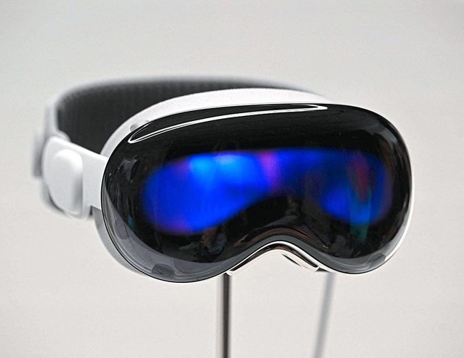
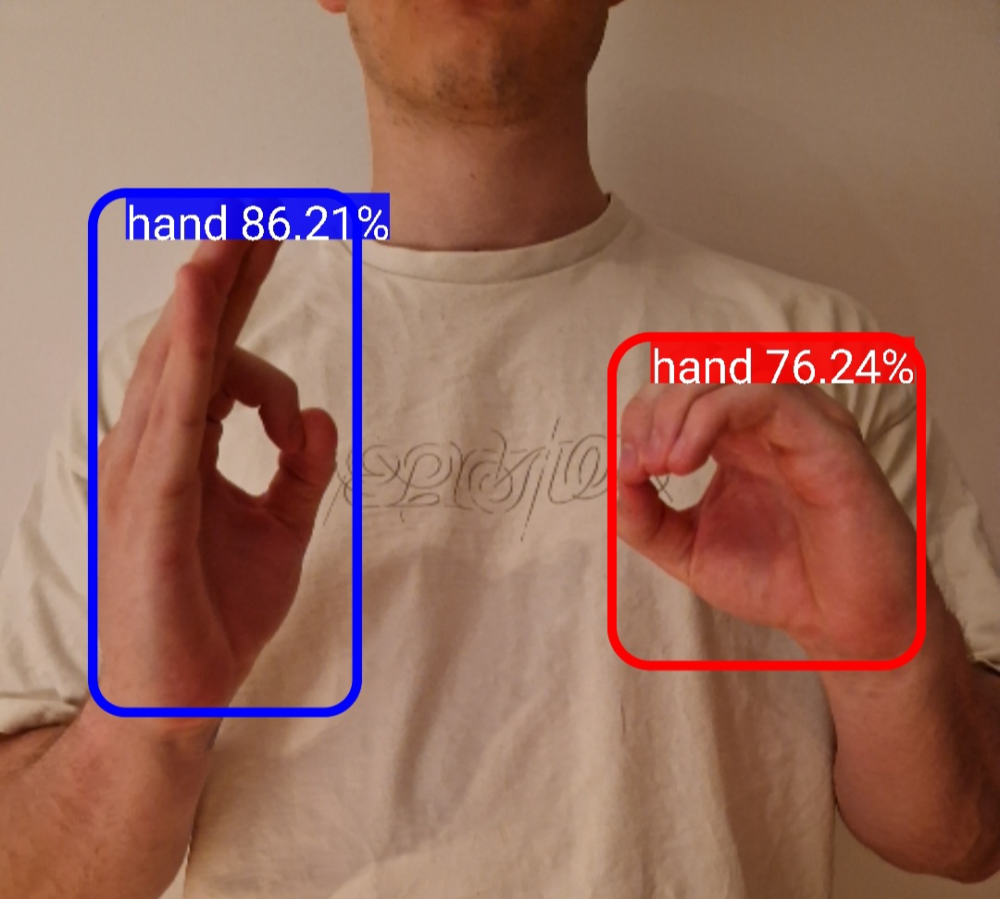
Introduction & Motivation
Advancements in computer vision algorithms and System-on-Chips for wearables
Smart glasses have opened up opportunities in AR and VR
Sign language aid as possible application
Feasibility study of real-time hand-detection on the SDW4100 SoC
Notes:
CV algorithms more efficient and capable due to ML + SoC have become more powerful to run these algorithms at the edge
One wearable that has profited from these advancements -> smart glasses like Apple Vision Pro
Sign language aid to break language barrier between deaf and non-deaf people -> real-time hand detection is principal component *CLICK*
This work is a feasibility study…

Slide 4

Background – YOLO
Real-time object detection algorithm proposed in 2016 by Joseph Redmond et al.
Bounding box prediction and class labels in single forward pass
Notes:
Background -> YOLO and target hardware
Single forward pass of one neural network -> You-only-look-once

Slide 5
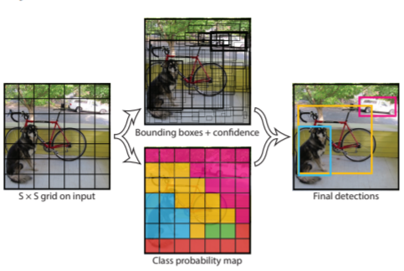
YOLO – Working Principle
Image divided into SxS grid
Each grid cell predicts B bounding boxes and C class probablities
Each bounding box is defined by:
Bounding box coordinates (x, y, w, h)
Confidence Score
Output Tensor of shape [S, S, 5B+C]
Notes:
Bounding box defined by 5 parameters

Slide 6
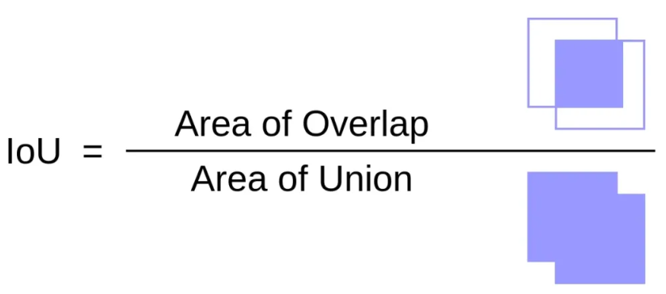
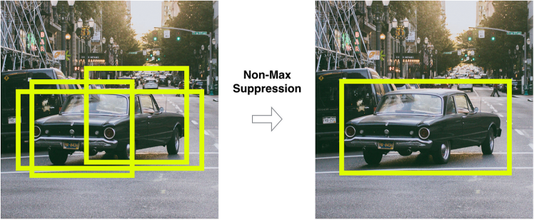
YOLO – Post-Processing
Post-Processing to remove redundant bounding boxes:
Confidence Thresholding: discard boxes with that fall below confidence threshold
For overlapping bounding boxes the Intersection over Union (IoU) is computed:
Non-maximum suppression (NMS): ignore low confidence bounding boxes that exceed IoU threshold
Notes:
YOLO predicts too many bounding boxes
NMS example: one rectangular, two square BBs

Slide 7
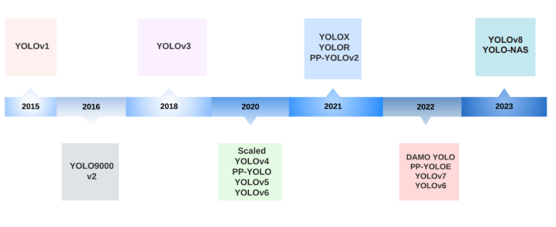
YOLO – Different Versions
Notes:
enhancements in network architectures & optimizations in training methods
YOLOv5 and v7 used since: commonly used, accesible

Slide 8
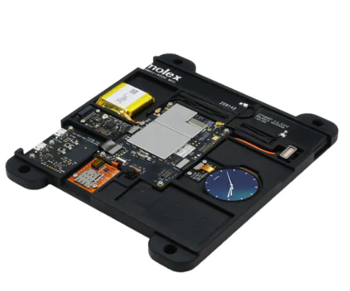
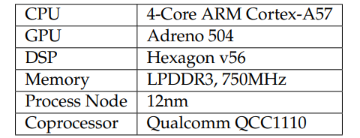
Background – SDW4100
Development-board with Snapdragon Wear 4100 SoC for Wearables and peripherals
Runs Android 8.1
DSP: acceleration enabled by MAC units
GPU: many cores, highly parallalizable

Slide 9
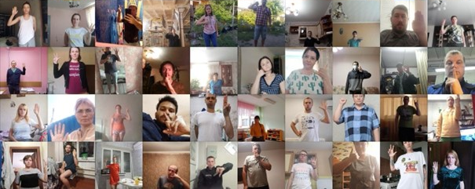
Implementation – Dataset
HaGRID (Hand Gesture Recognition Dataset)
552’992 Full HD Images, 34’000 different people and scenes
18 different gestures, third person, 0.5-2m distance to camera
Notes:
ML models need a well-balanced dataset
Had to convert HaGRID labels to YOLO labels

Slide 10
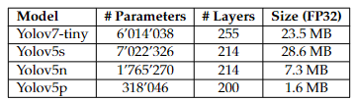
Implementation – Training
Input sizes used: 640x640, 320x320, 224x224
Training on PBL server:
Training-test split → 92% and 8%
Pretrained weights from models trained COCO dataset
One epoch with SGD
Notes:
Wide variety of models to explore speed and accuracy trade-off

Slide 11
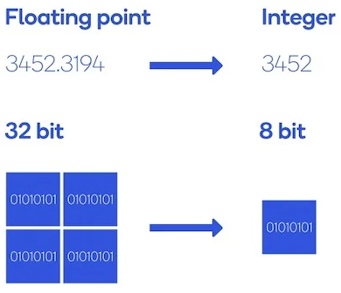
Implementation – Optimizations
Input Size:
Smaller input → less convolutional/pooling operations → faster inference
Quantization:
Represent network parameters (weights & biases) with 8-bit integer instead of 32-bit floating point precision
Reduced Memory footprint (4x) and faster inference time

Slide 12
Implementation – Export Flow
Target framework used for Android deployment and NNAPI development
Export to Open Neural Network Exchange
YOLO framework used for training and evaluation
Intermediate framework, workaround for mismatch in input format (NCHW vs. NHWC*)
* Batch Size, Height, Width, #Channels
Notes:
Start at PyTorch, goal is TensorFlow Lite

Slide 13
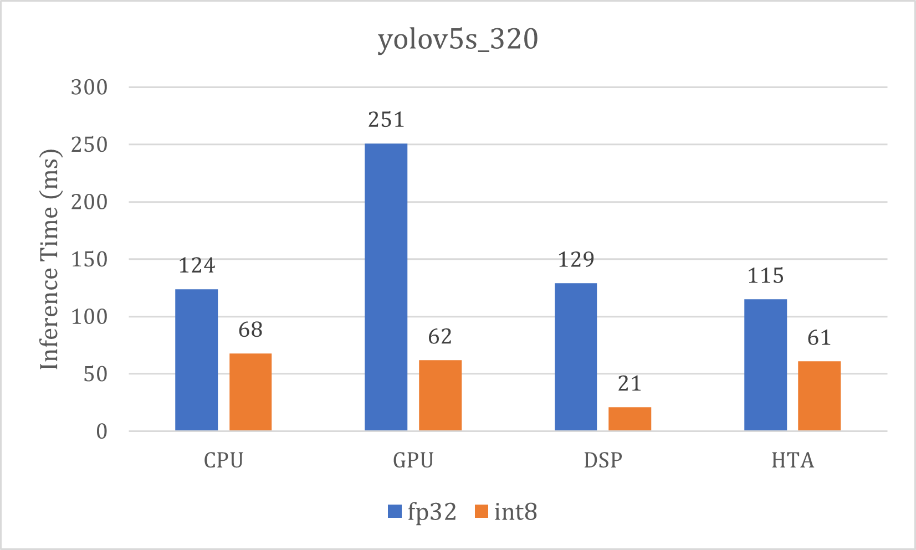
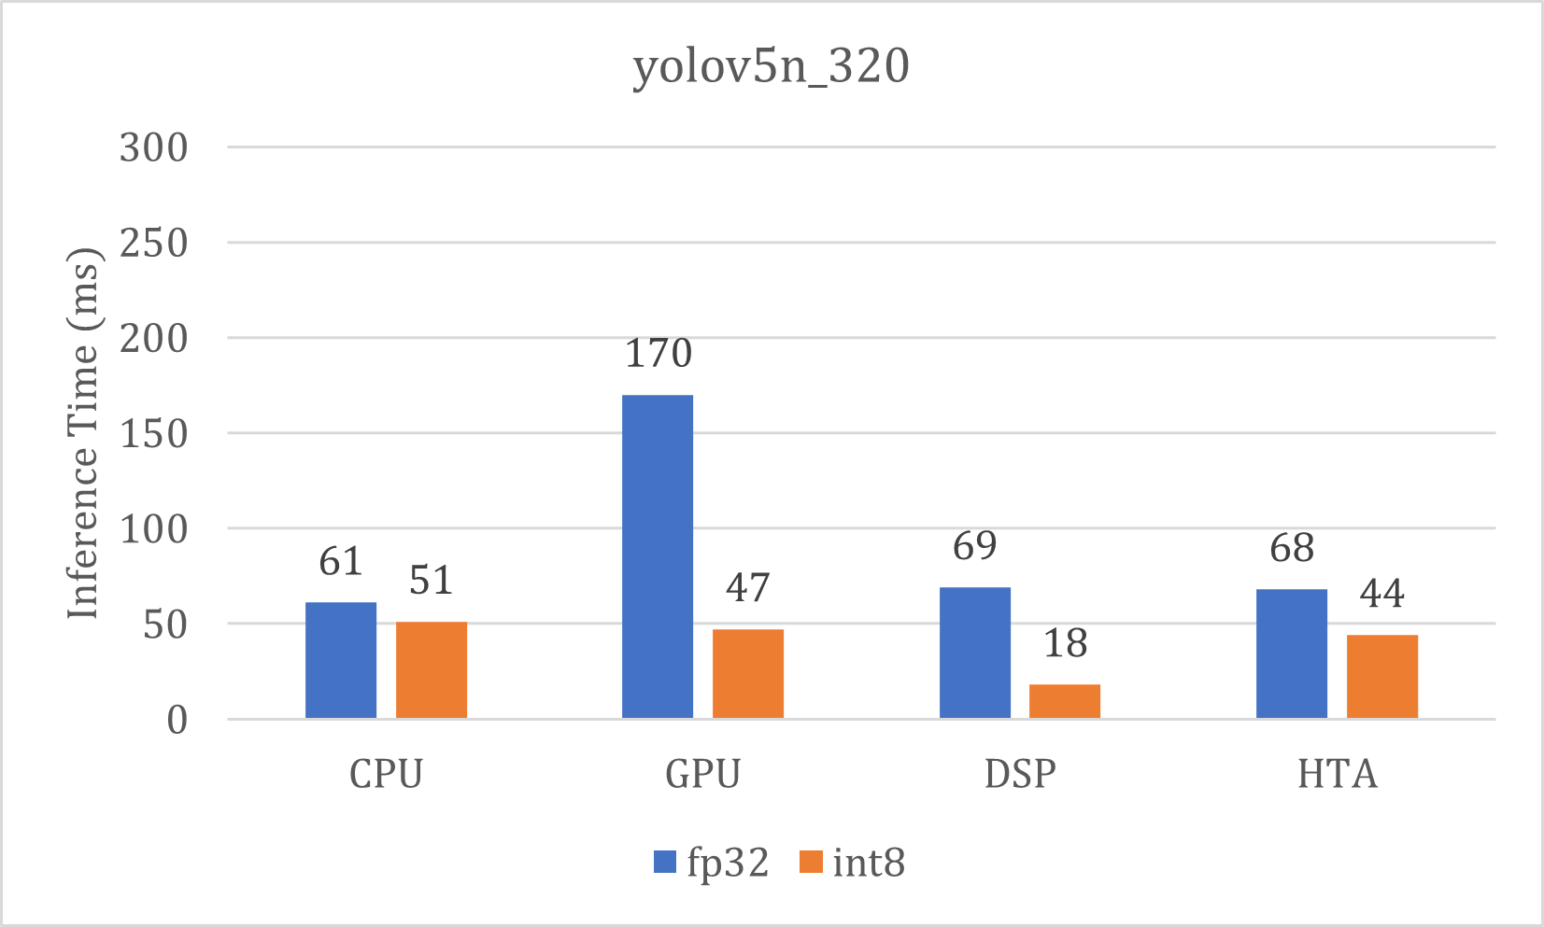
Implementation – NNAPI
Hardware acceleration delegate for TensorFlow Lite models
OnePlus 7 Pro with Snapdragon 855 → complete NNAPI support (GPU, DSP, HTA)
DSP best for quantized models, otherwise Hexagon Tensor Accelerator (HTA) or CPU
Notes:
Substantial acceleration for quantized models on DSP

Slide 14
Implementation – Limitations
NNAPI on SDW4100 doesn’t support DSP acceleration
YOLOv7 not fully supported by TensorFlow Lite → PyTorch Mobile
Notes:
Two limitations detected
No DSP support; GPU sole accelerator option
PyTorch Mobile, less optimized framework, no hardware accleration

Slide 15
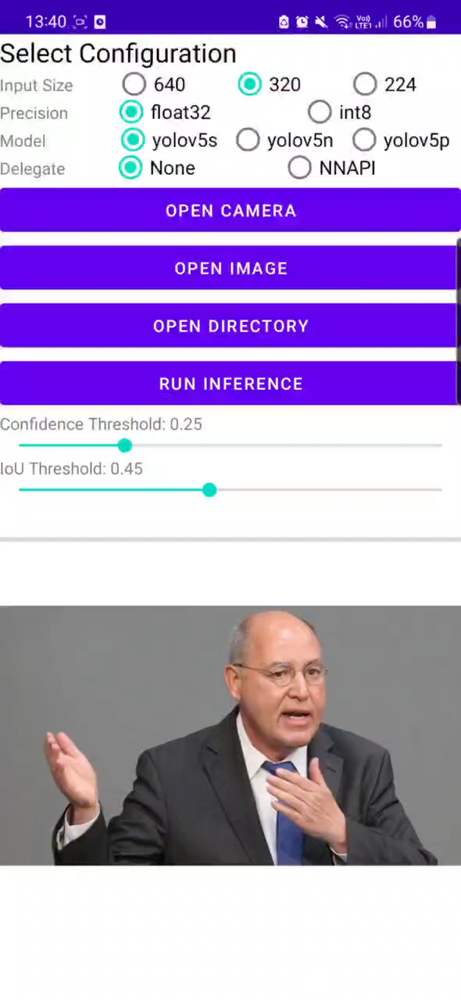
Implementation – Android App
Notes:
Select Config (input size, quantization, model, delegate)
change post-processing parameters
inference on image or real-time detection with camera

Slide 16
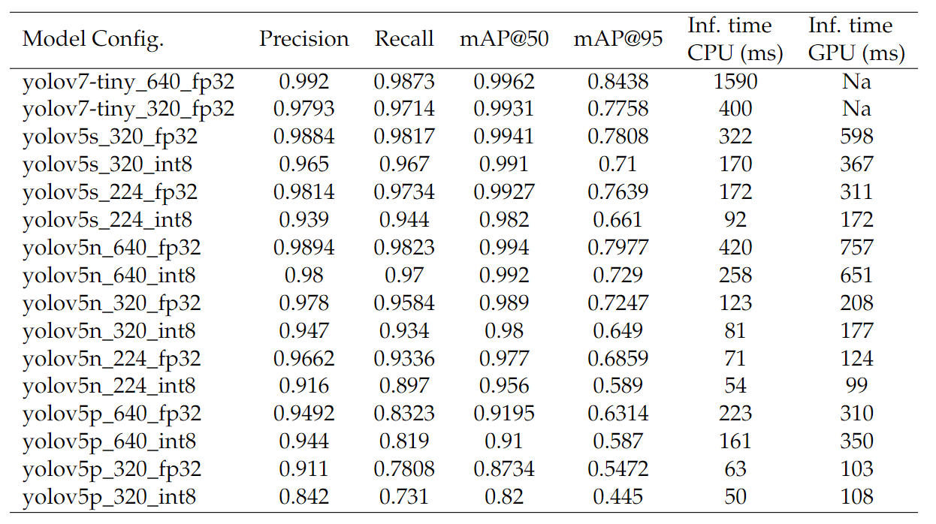
Results – SDW4100
Based on test set (44’000 images)
PyTorch Mobile
TensorFlow Lite
Notes:
Models
Metrics (accuracy and inference speed)

Slide 17
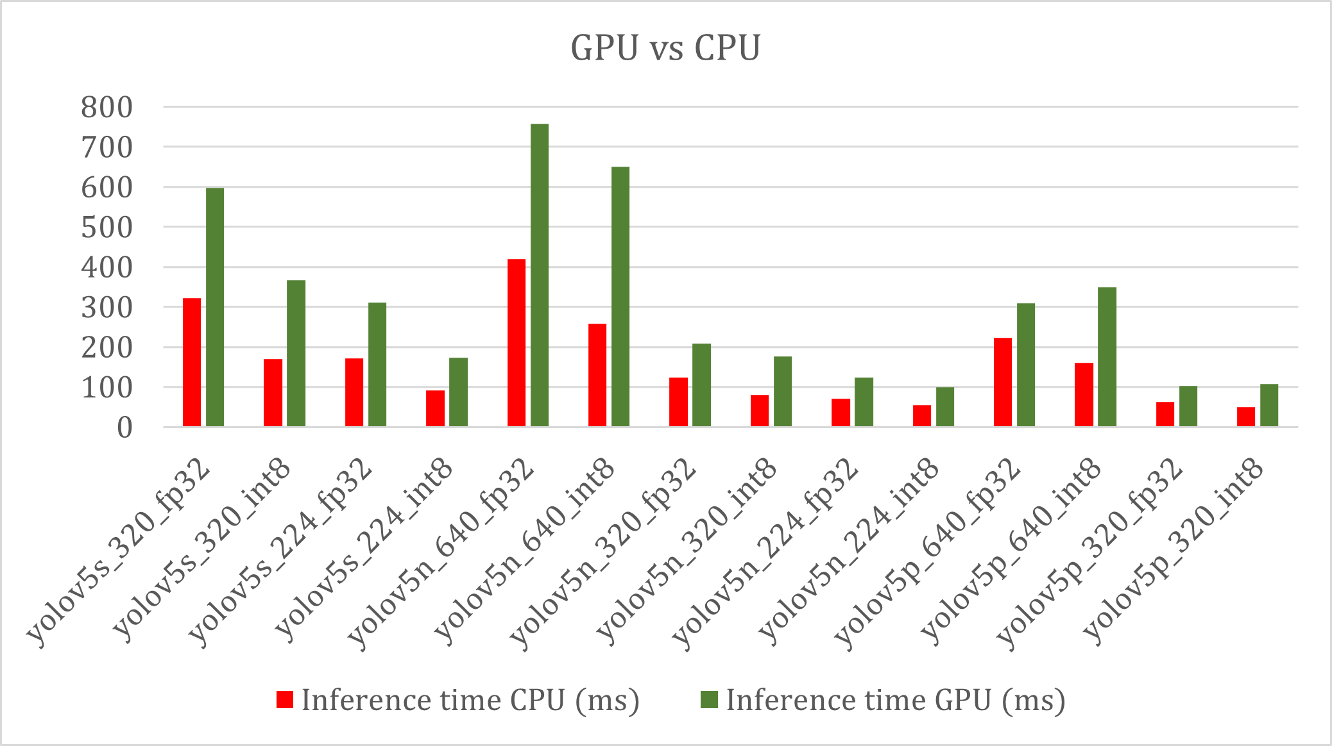
Results – GPU vs. CPU
GPU execution yields 2x slowdown on all models
Lacking NNAPI drivers → CPU fall back execution

Slide 18
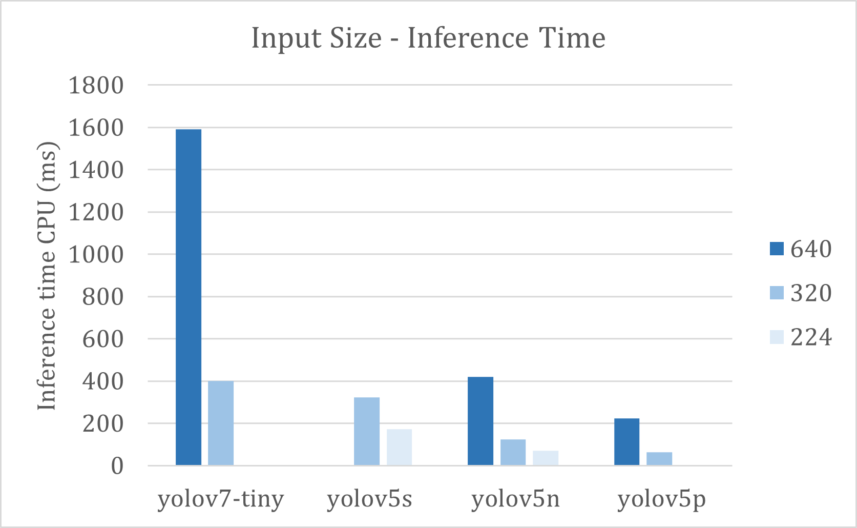
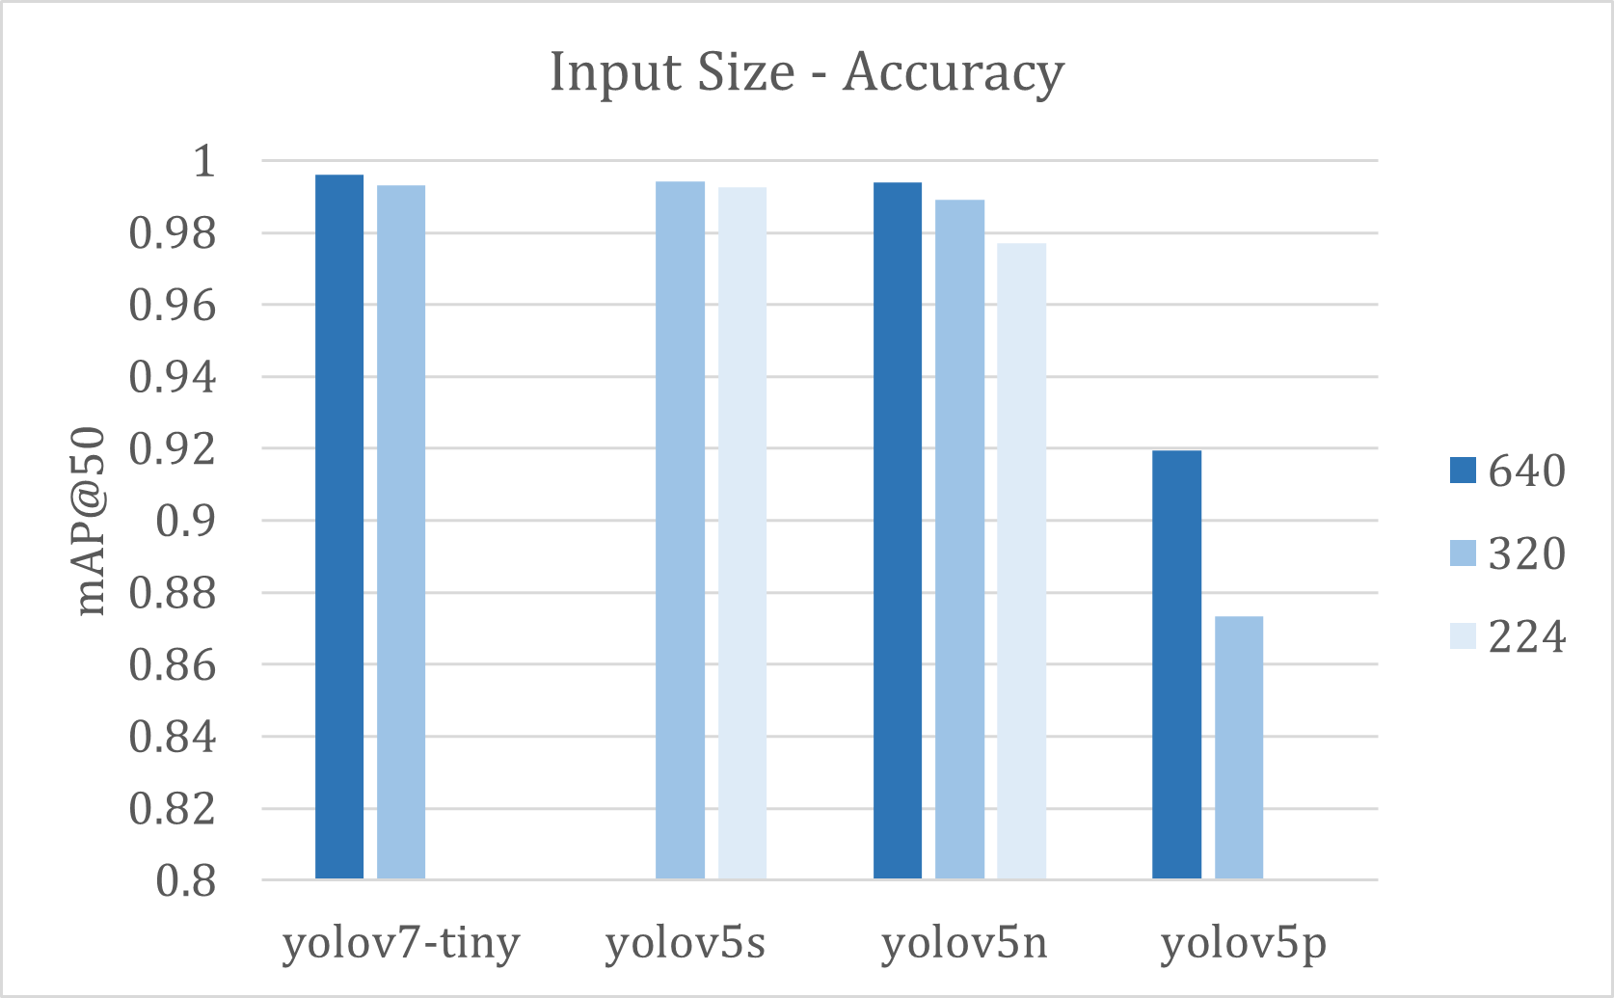
Results – Input Size
Input size scales 1 to 1 with inference time
Number of convolutional operations scales with input size
Bigger reduction in accuracy for smaller models
Viable optimization method

Slide 19
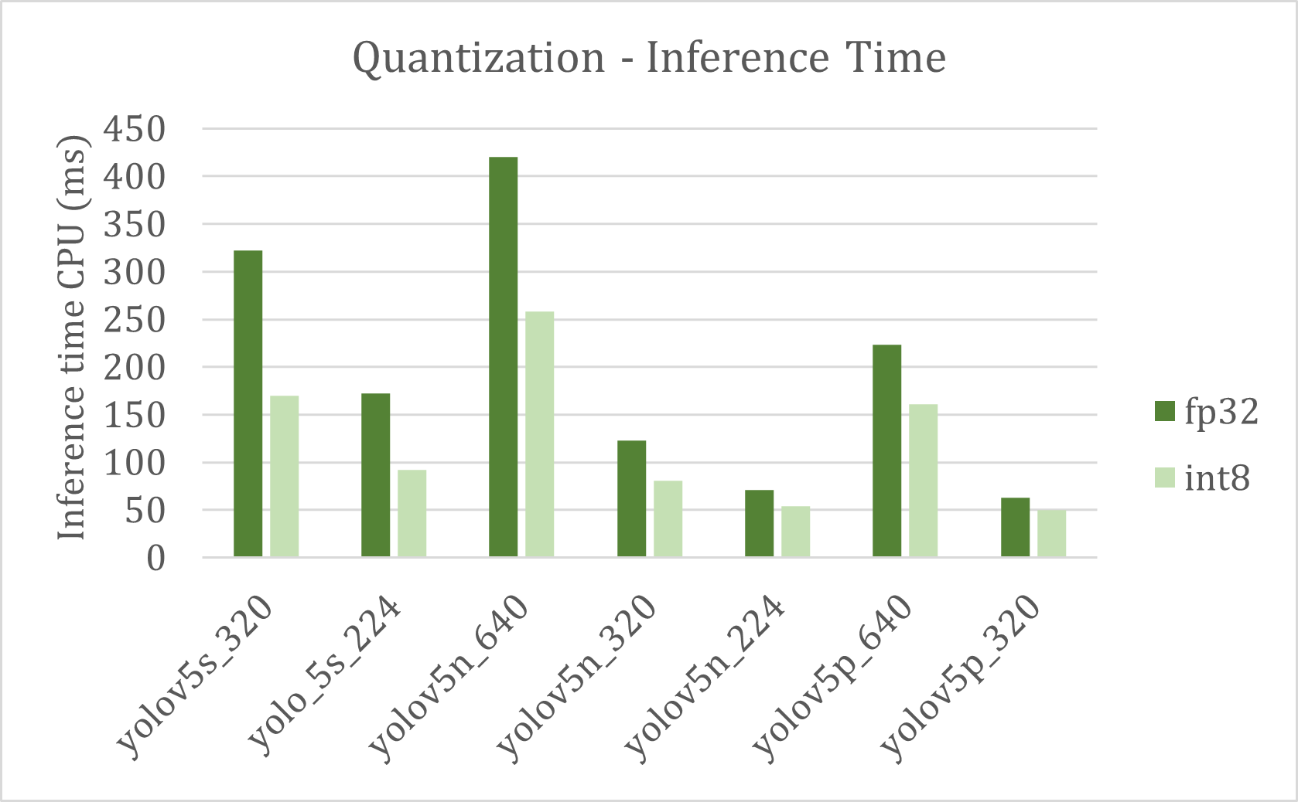
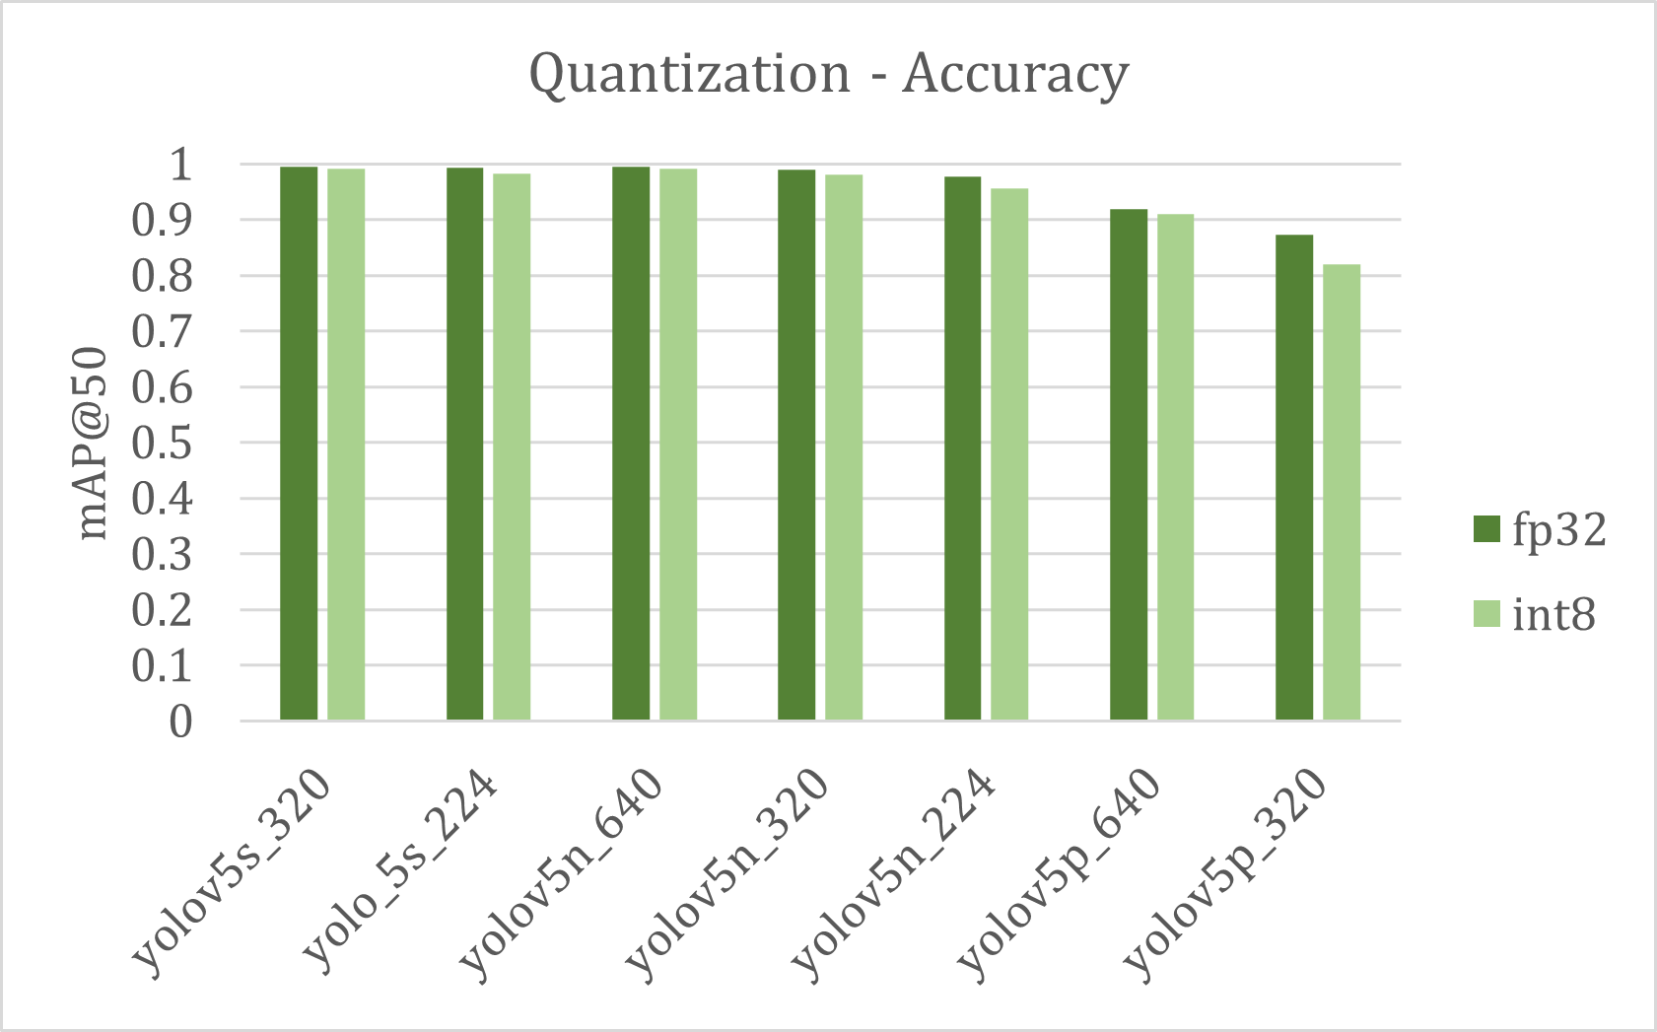
Results – Quantization
Quantization yields better inference time
Integer instr. faster than FP instr.
Less bandwidth and cache size required
Diminishing returns for smaller models
Less data transfer overhead as model size approaches cache size
Potential acceleration with integer-based DSP

Slide 20
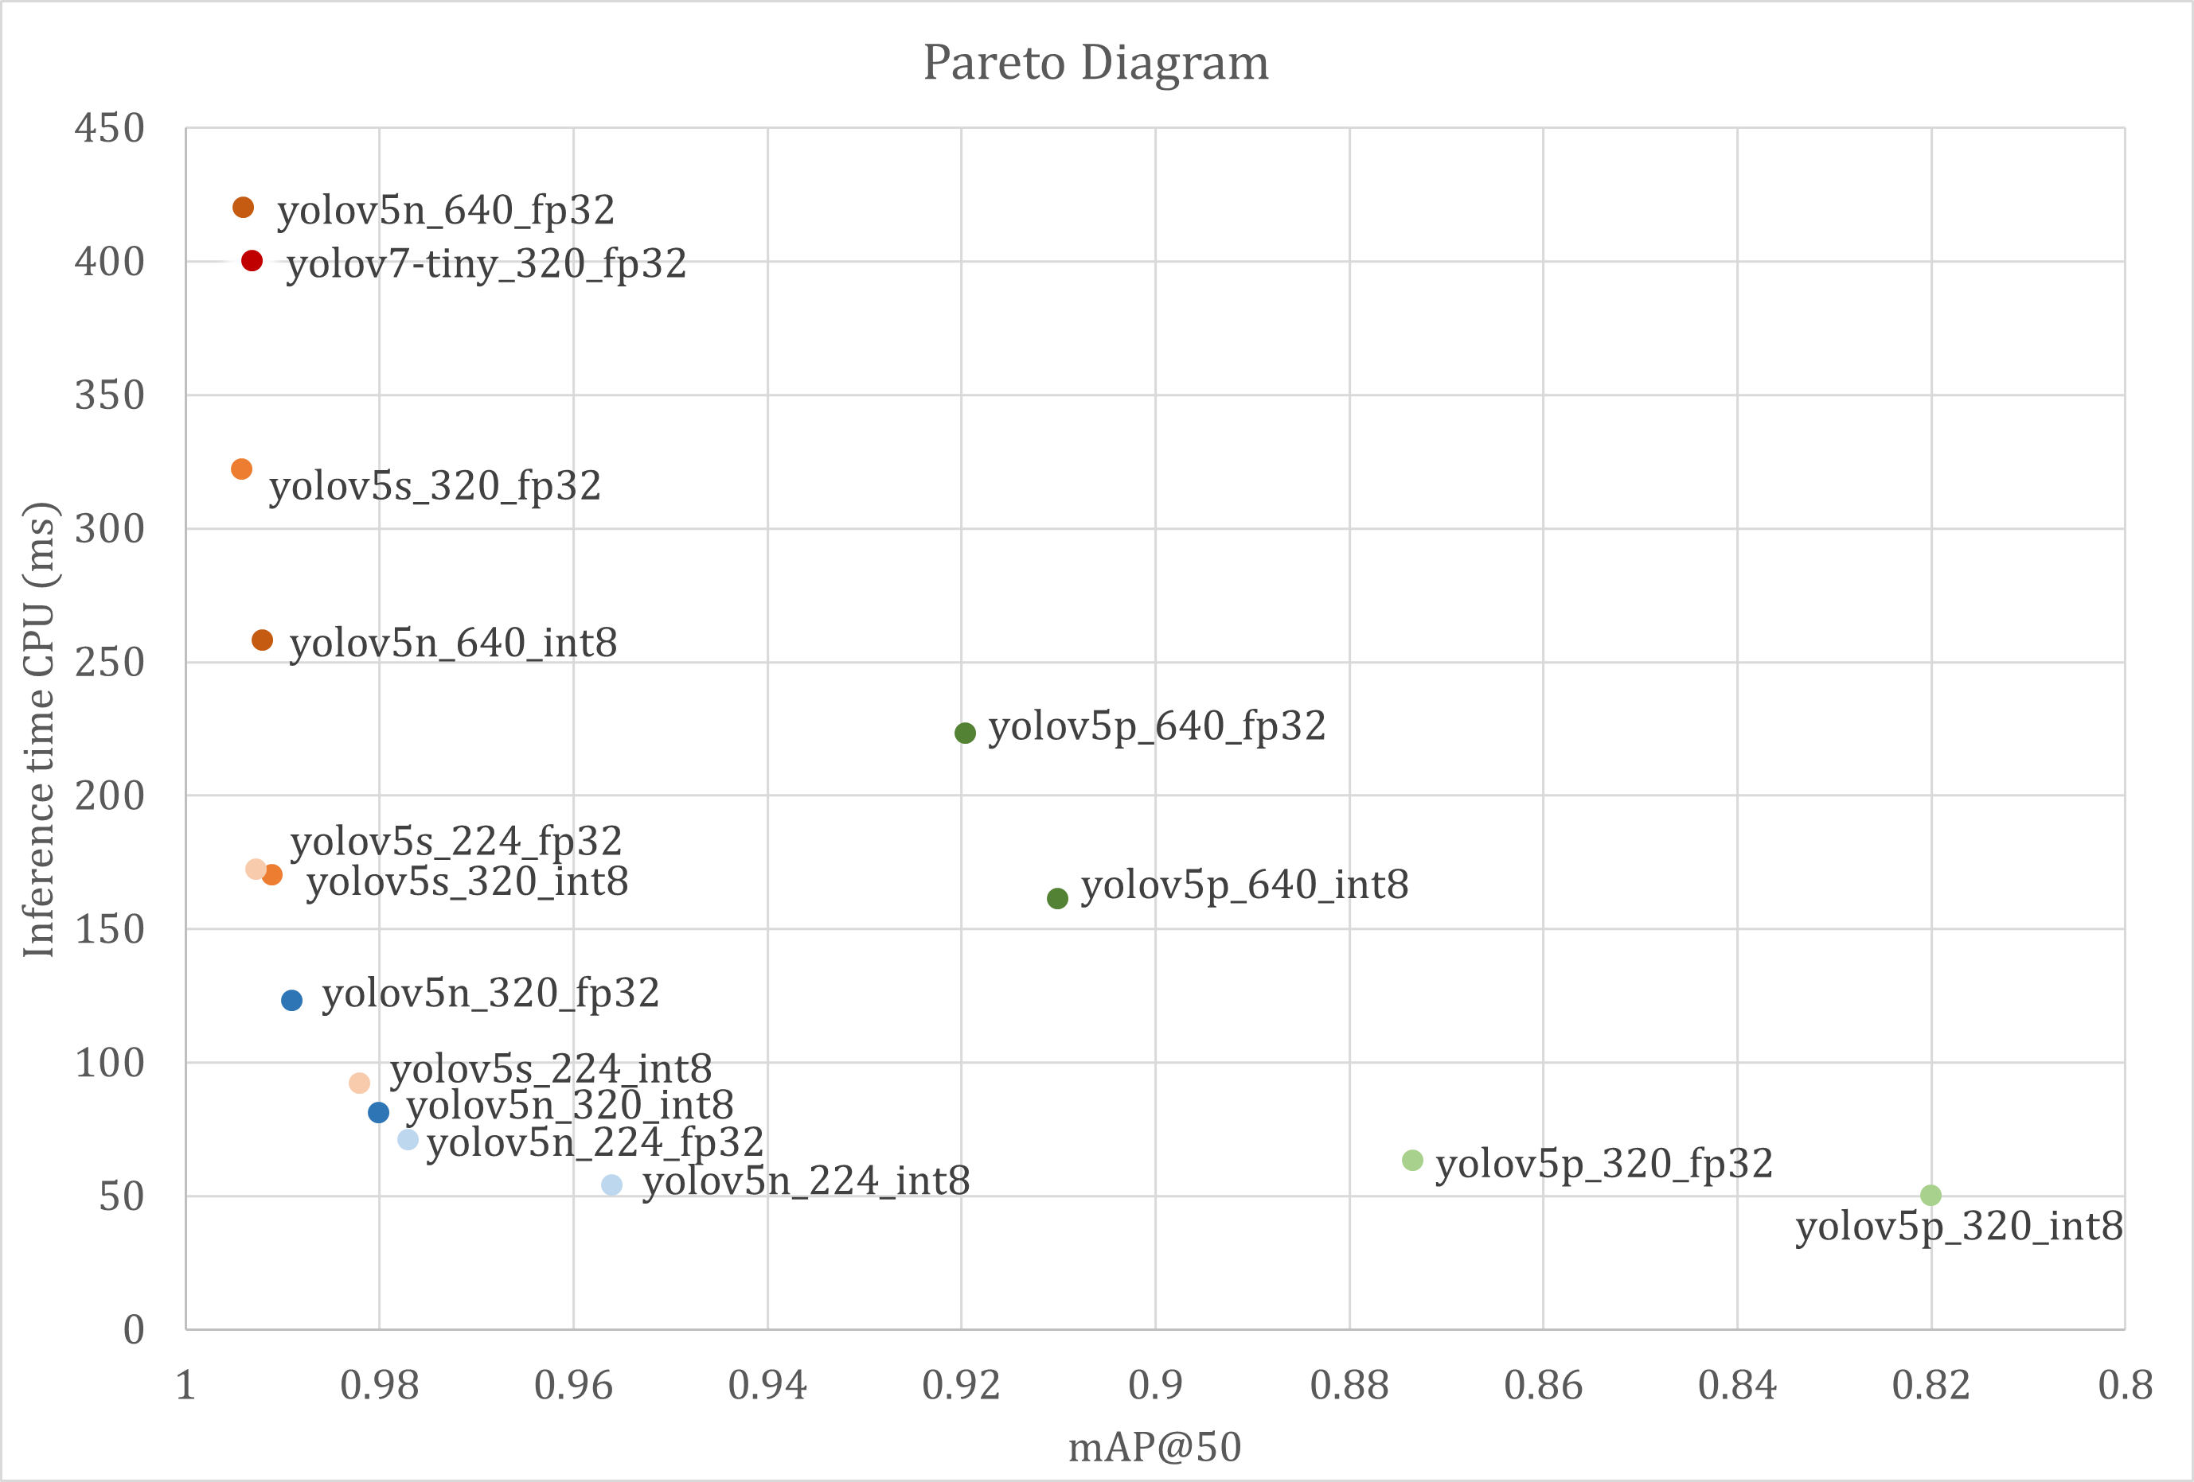
Results – Pareto Diagram
Model
yolov7-tiny
yolov5s
yolov5n
yolov5s
optimal
Input Size
640 224
Notes:
YOLOv7 worse than YOLOv5 due to different framework
L-shape
Pareto-front for reliable real-time detection (<100ms)

Slide 21
Conclusions
Training of YOLO and deployment on SoC for wearables
Real-time hand detection with inference time of 71 ms and mAP of 0.977 (yolov5n_224_fp32)
No acceleration achieved with NNAPI
Input size was most influential optimization
Newer architectures (YOLOv7) lack framework compatibility
Notes:
We have seen
It was shown

Slide 22

Questions

Slide 23
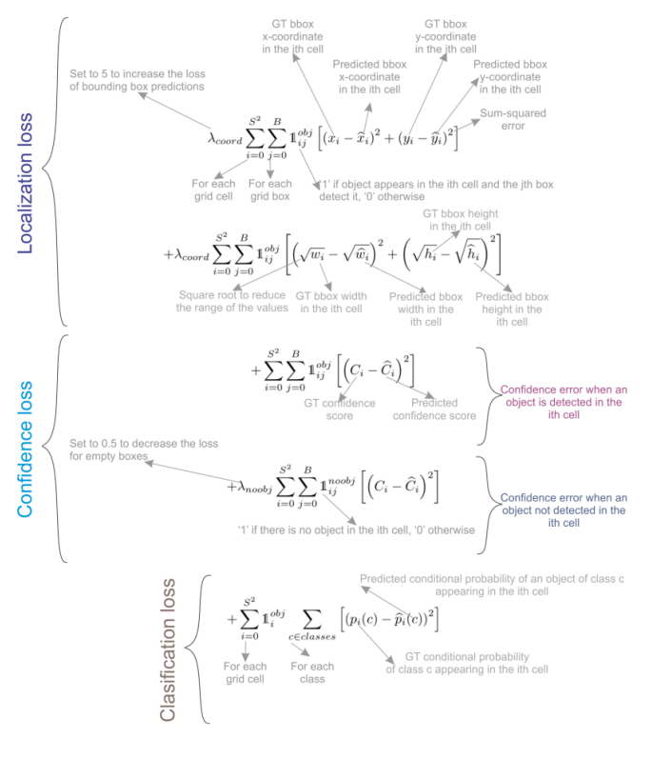
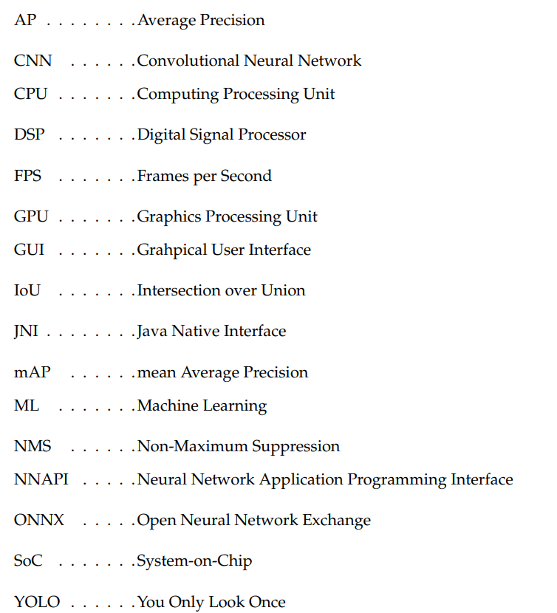
Backup

Slide 24
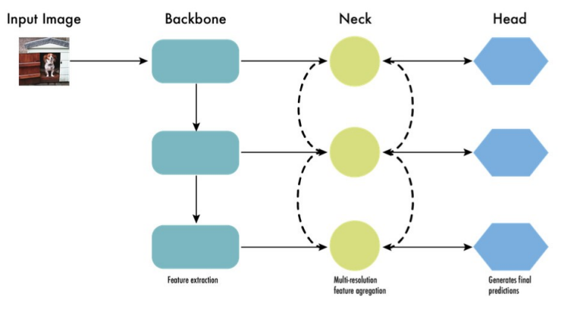
Backup – YOLO
Architecture has three components:
Loss function is the weighted sum of:
Localization Loss: measures difference between predicted bounding boxes and ground truths
Confidence Loss: cross entropy loss, penalizes wrong predictions
Classifcation Loss: penalizes wrong class labels

Slide 25
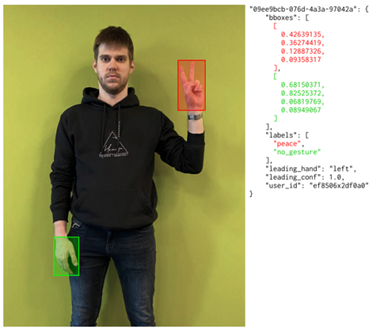
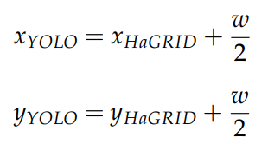
Backup – HaGRID
HaGRID annotations in JSON format
Conversion to YOLO lables:
All gestures → single hand class
Bounding box coordinates:
Remaining annotations omitted

Slide 26
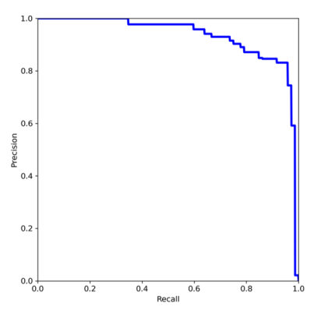
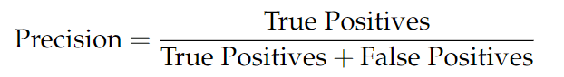
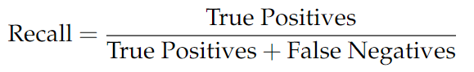
Backup – Metrics
Precision: measures if detections are in fact hands
Recall: measures if all present hands were detected
PR Curve: plots precision and recall pairs for different confidence thresholds
AP/mAP: corresponds to the area under the PR curve

Slide 27
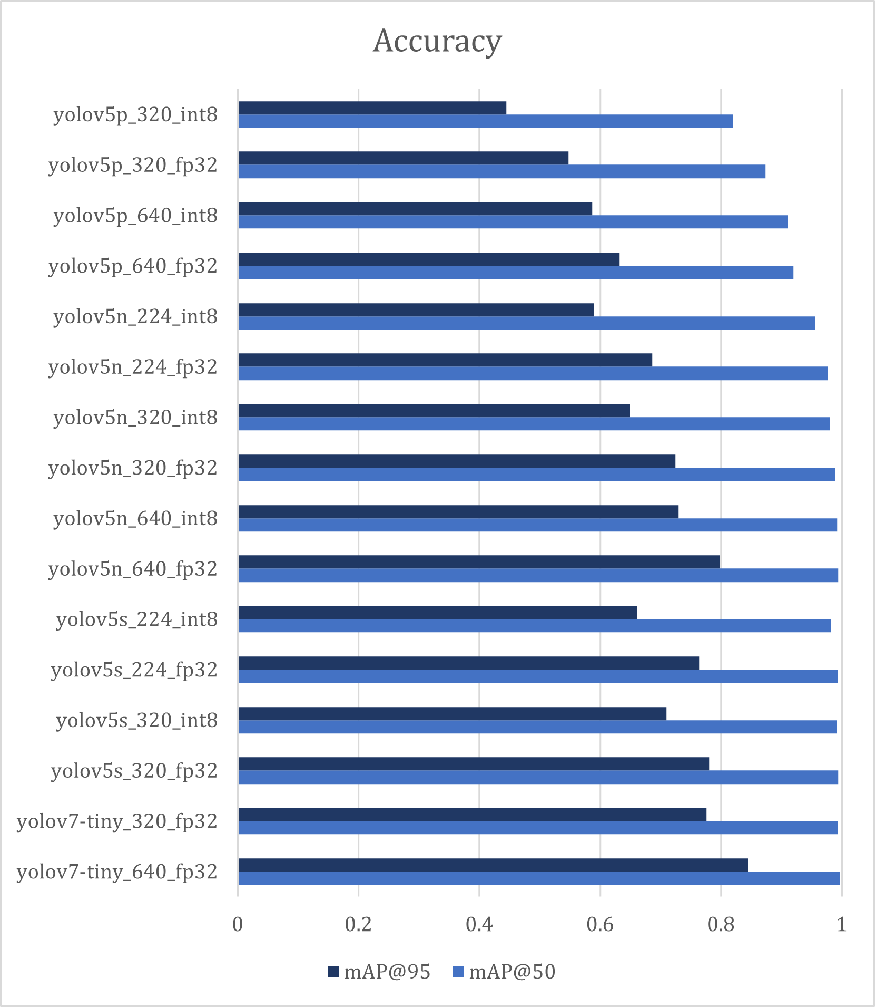
Backup – Slides
mAP is most comprehensive accuracy metric
mAP at 50% and 95% IoU threshold
Decreasing accuracy with model and input size
yolov5p too small to capture task complexity
yolov7-tiny on par with yolov5s

